Slide 1

CS+Social Good
CS 106S Winter 2018

Slide 2

outline
the problem
machine learning
cancer diagnosis assignment
today’s outline
1 breast cancer overview
2 intro to machine learning
3 cancer diagnosis assignment

Slide 3
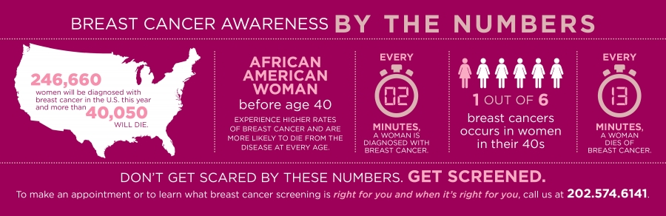
outline
the problem
machine learning
cancer diagnosis assignment
breast cancer

Slide 4
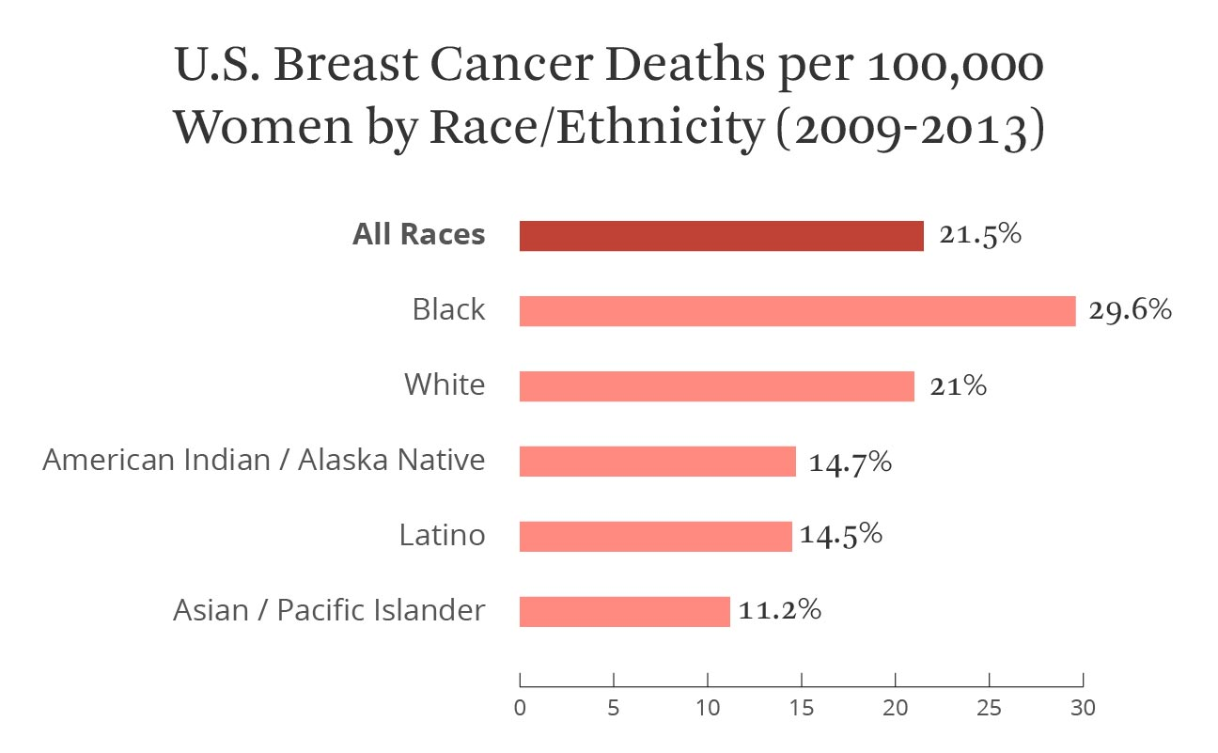
outline
the problem
machine learning
cancer diagnosis assignment
breast cancer
Notes:
2nd most deadly cancer for women in the US

Slide 5
outline
the problem
machine learning
cancer diagnosis assignment
breast cancer
error rates as high as 71%
mistakes are common depending on the doctor
31% of all cases misdiagnosed
90,000 women misdiagnosed
Notes:
http://www.bostonmagazine.com/health/2013/01/31/study-cancer-misdiagnose/
also one of the most misdiagnosed cancers
The Journal of the National Cancer Institute reported error rates as high as 71 percent in certain situations. Mistakes are especially common when the patient’s doctor doesn’t specialize in breast cancer. Further, experts believe as many as 31 percent of all breast cancer cases are misdiagnosed, according to the New England Journal of Medicine. As many as 90,000 women are misdiagnosed with invasive breast cancer, The New York Times reported.

Slide 6
outline
the problem
machine learning
cancer diagnosis assignment
today’s task
Given medical data about cell growths, can we accurately classify tumors as benign or malignant using machine learning?
Notes:
http://www.bostonmagazine.com/health/2013/01/31/study-cancer-misdiagnose/
also one of the most misdiagnosed cancers
The Journal of the National Cancer Institute reported error rates as high as 71 percent in certain situations. Mistakes are especially common when the patient’s doctor doesn’t specialize in breast cancer. Further, experts believe as many as 31 percent of all breast cancer cases are misdiagnosed, according to the New England Journal of Medicine. As many as 90,000 women are misdiagnosed with invasive breast cancer, The New York Times reported.

Slide 7
outline
the problem
machine learning
cancer diagnosis assignment
today’s task matters because…
Classifying tumors allows:
Doctors to diagnose cancer with greater accuracy
Doctors and patients to make more informed decisions
Medical costs to be reduced and diagnosing processes to become more efficient
Notes:
http://www.bostonmagazine.com/health/2013/01/31/study-cancer-misdiagnose/
also one of the most misdiagnosed cancers
The Journal of the National Cancer Institute reported error rates as high as 71 percent in certain situations. Mistakes are especially common when the patient’s doctor doesn’t specialize in breast cancer. Further, experts believe as many as 31 percent of all breast cancer cases are misdiagnosed, according to the New England Journal of Medicine. As many as 90,000 women are misdiagnosed with invasive breast cancer, The New York Times reported.

Slide 8
outline
the problem
machine learning
cancer diagnosis assignment
what is machine learning?
Machine learning is a “field of study that gives computers the ability to learn without being explicitly programmed.”
-Arthur Samuel, 1959
Notes:
does anyone know what the two types of machine learning are?

Slide 9
outline
the problem
machine learning
cancer diagnosis assignment
types of machine learning
Supervised
Unsupervised
Notes:
can anyone guess what supervised vs unsupervised machine learning is?

Slide 10
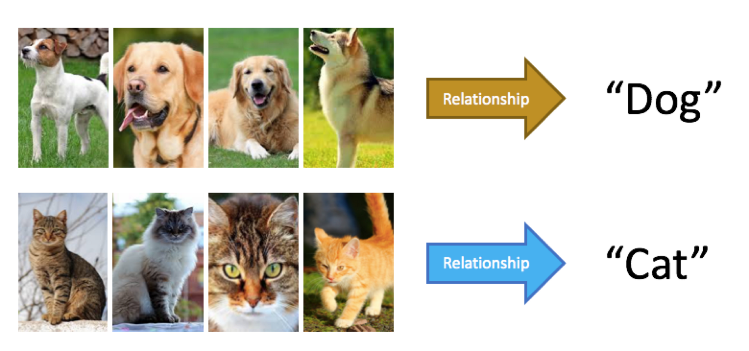
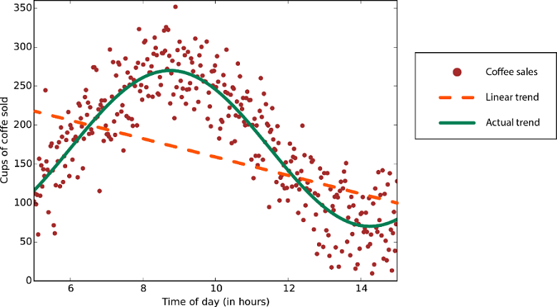
outline
the problem
machine learning
cancer diagnosis assignment
supervised machine learning
Notes:
classification
regression

Slide 11
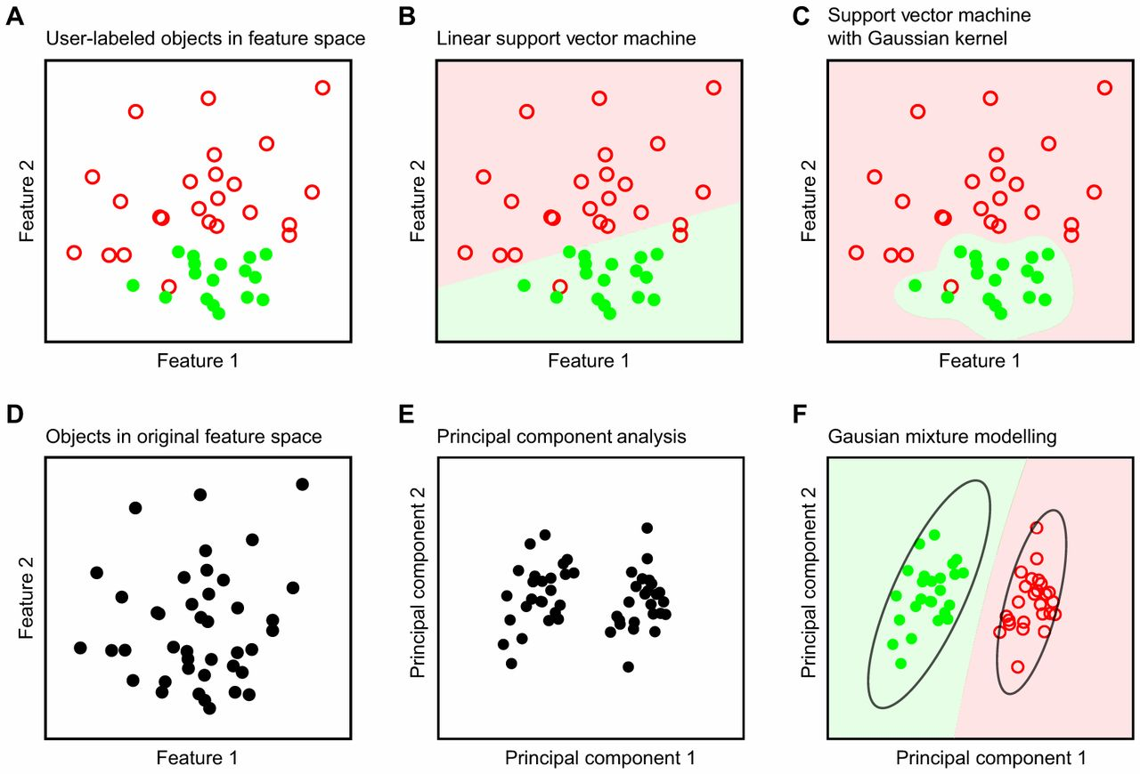
outline
the problem
machine learning
cancer diagnosis assignment
unsupervised machine learning

Slide 12
outline
the problem
machine learning
cancer diagnosis assignment
our data
~700 total data instances
We are training on ~630, testing on ~70
Each data instance has 11 values
Sample code number
Clump thickness (1-10)
Uniformity of Cell Size (1-10)
Uniformity of Cell Shape (1-10)
Marginal Adhesion (1-10)
Label (2=benign, 4=malignant)
Single Epithelial Cell Size (1-10)
Bare Nuclei (1-10)
Bland Chromatin (1-10)
Normal Nucleoli (1-10)
Mitosis (1-10)

Slide 13
outline
the problem
machine learning
cancer diagnosis assignment
implementation steps
Calculate distance between test instance and every train instance
Pick the K train instances with the smallest distances
Of these K train instances, see how many are classified as malignant and how many are classified as benign
Pick whichever class appears more times as your answer

Slide 14
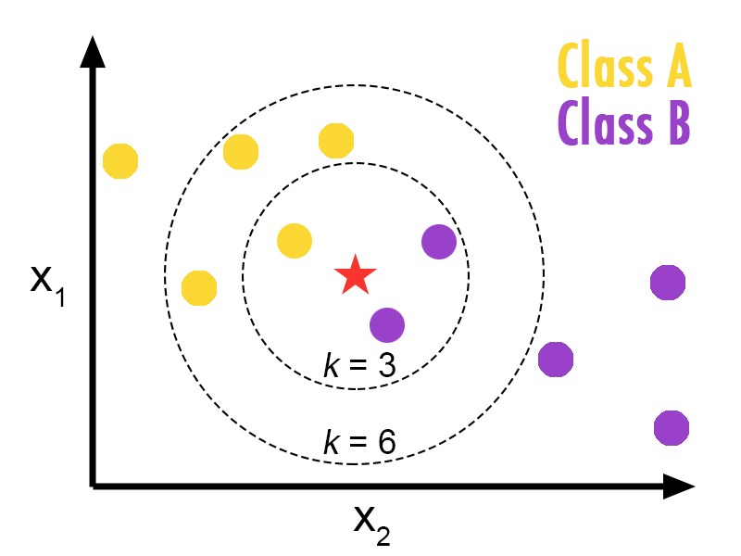
outline
the problem
machine learning
cancer diagnosis assignment
K-Nearest Neighbors

Slide 15
outline
the problem
machine learning
cancer diagnosis assignment
let’s get started!
Build your own breast cancer classifier using JavaScript!
Clone the code at bit.ly/cs106srepo and fill in cancer-classify.js located in cancer-diagnosis/javascript.
Run python –m SimpleHTTPServer in the above folder and examine the console output to test your solution.

Slide 16

outline
the problem
machine learning
cancer diagnosis assignment
extra challenge
Look up k-means and implement it with 2 clusters.
“k-means clustering aims to partition n observations into k clusters in which each observation belongs to the cluster with the nearest mean, serving as a prototype of the cluster.”

Slide 17
Checkoff form: bit.ly/cs106s-checkoff-cancer
See you next time, friends!

